Slide 1

Material Design 3
Color Guidelines

Slide 2
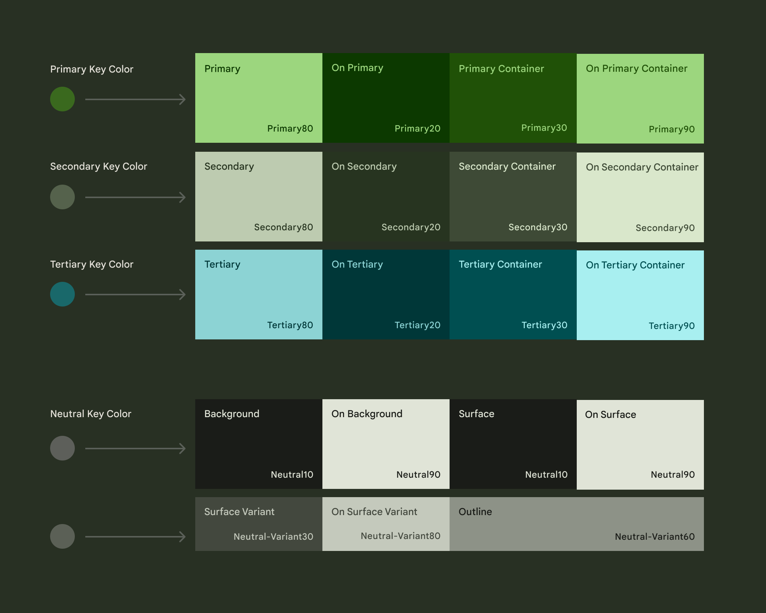

Slide 3
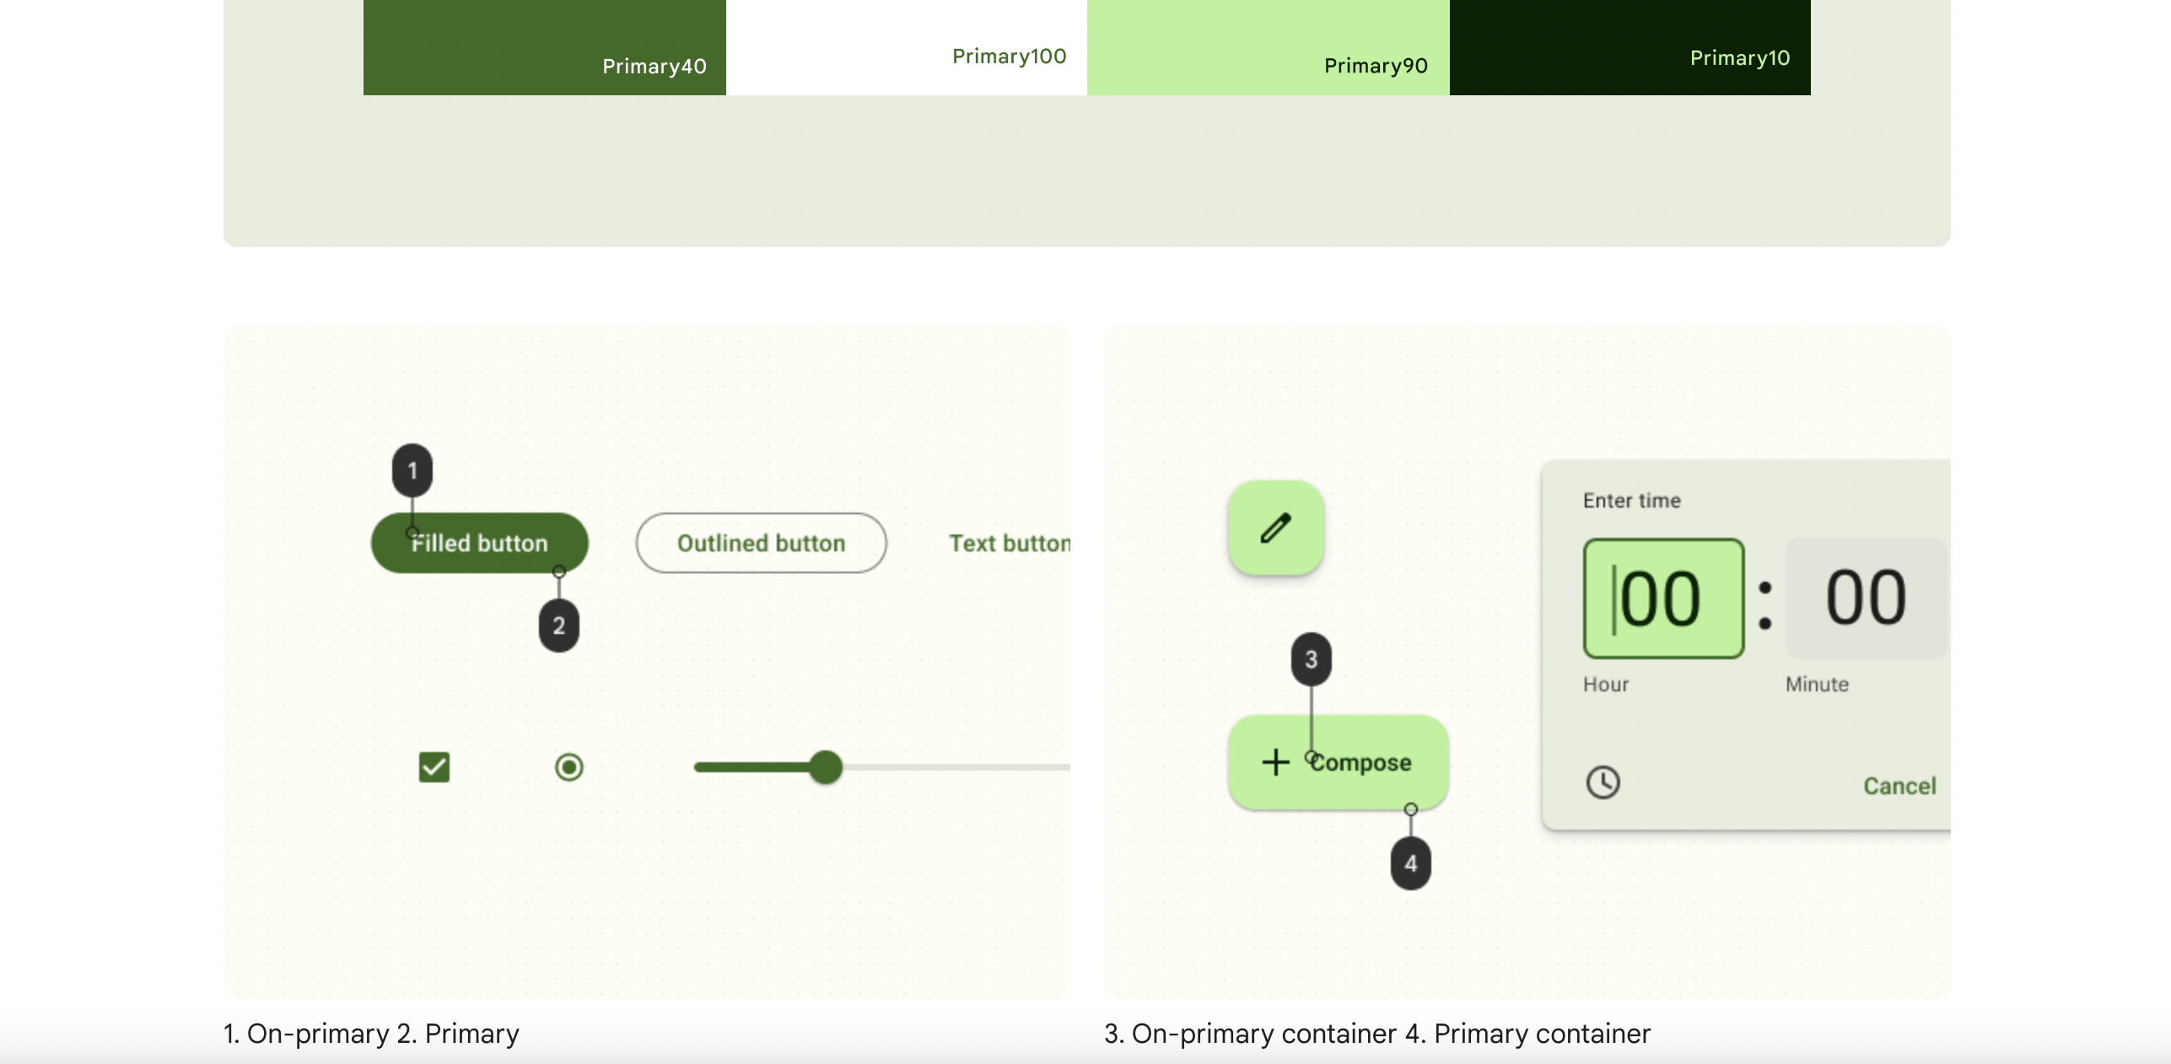

Slide 4
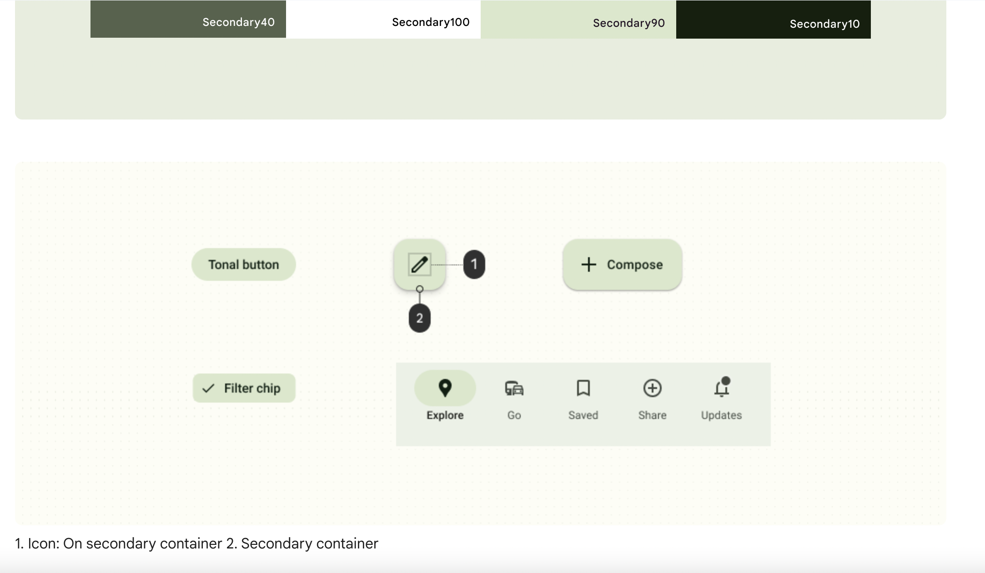

Slide 5
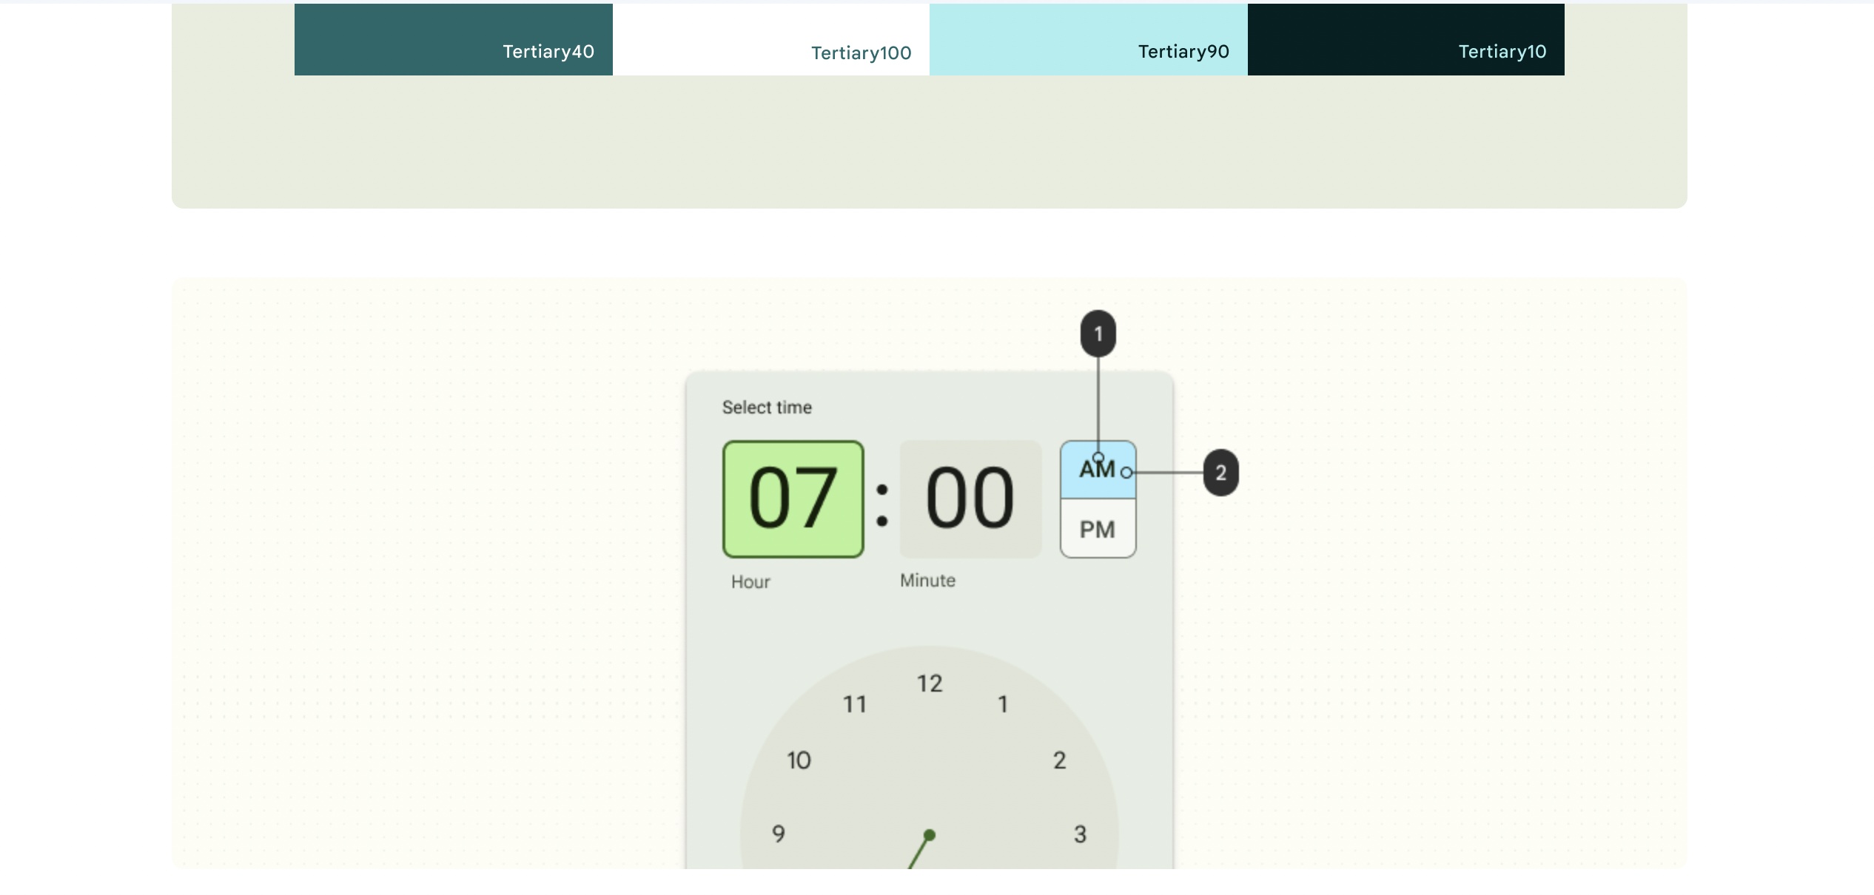

Slide 6
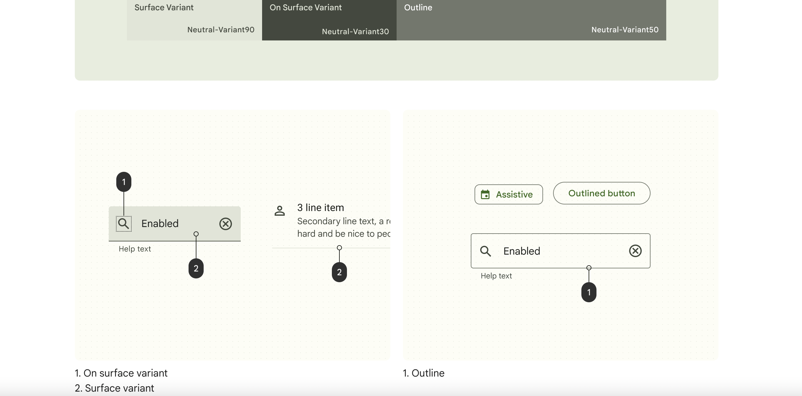

Slide 7
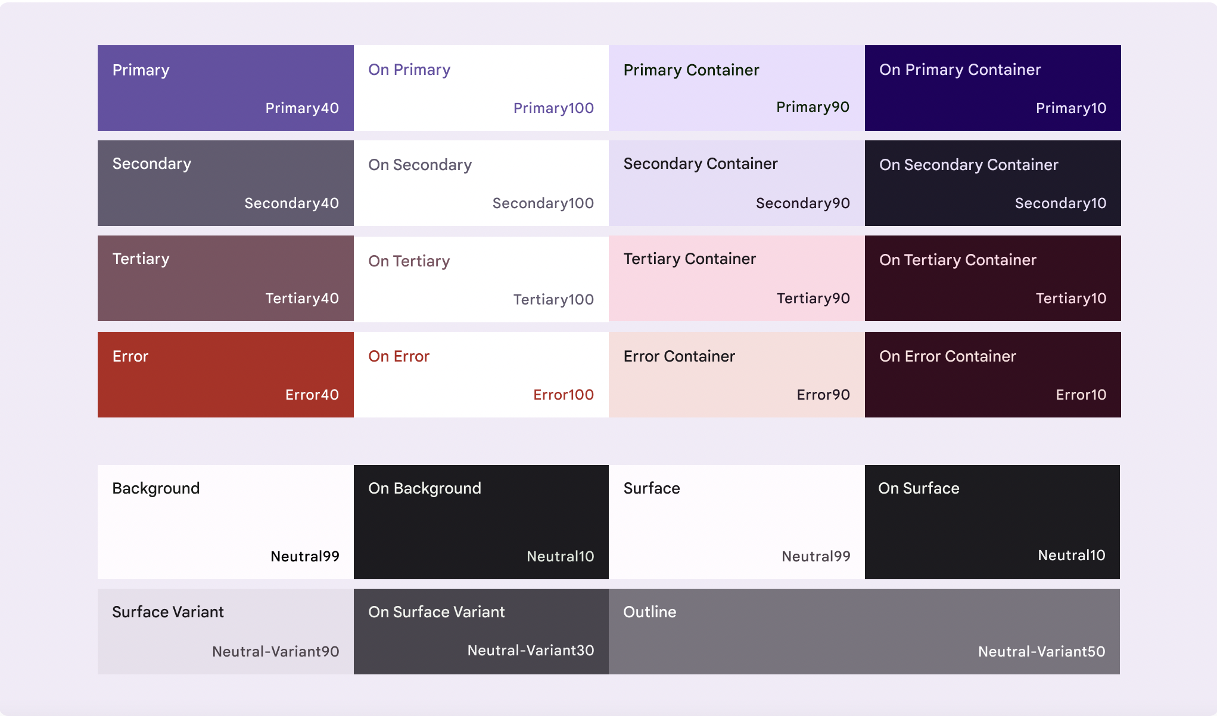

Slide 8
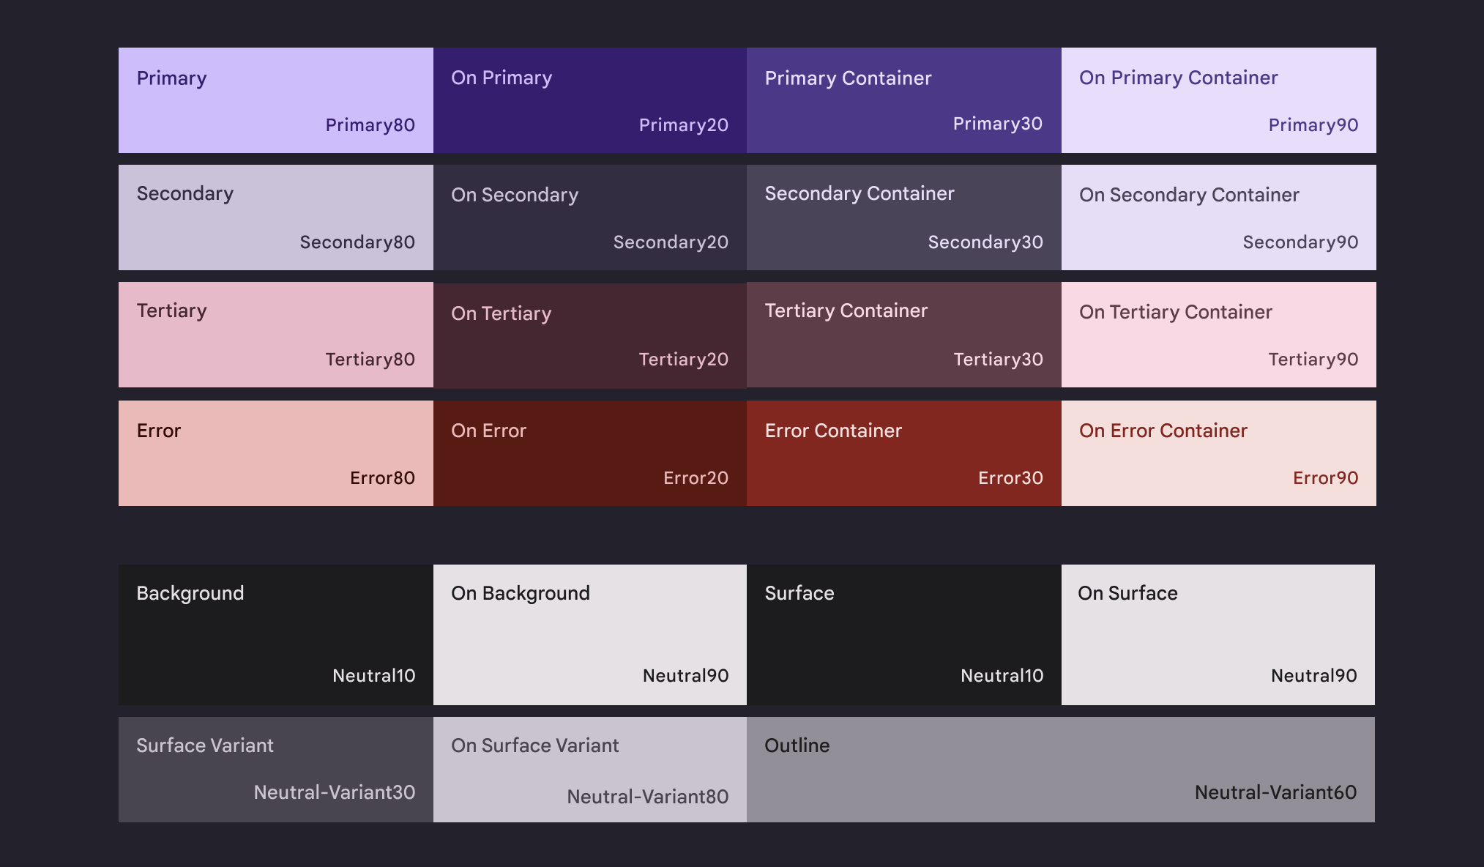

Slide 9
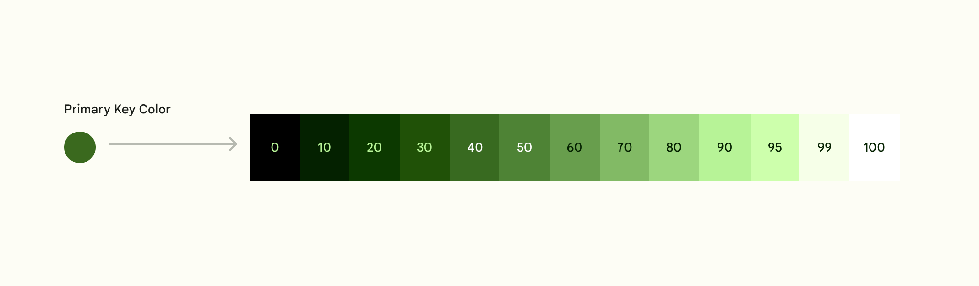

Slide 10
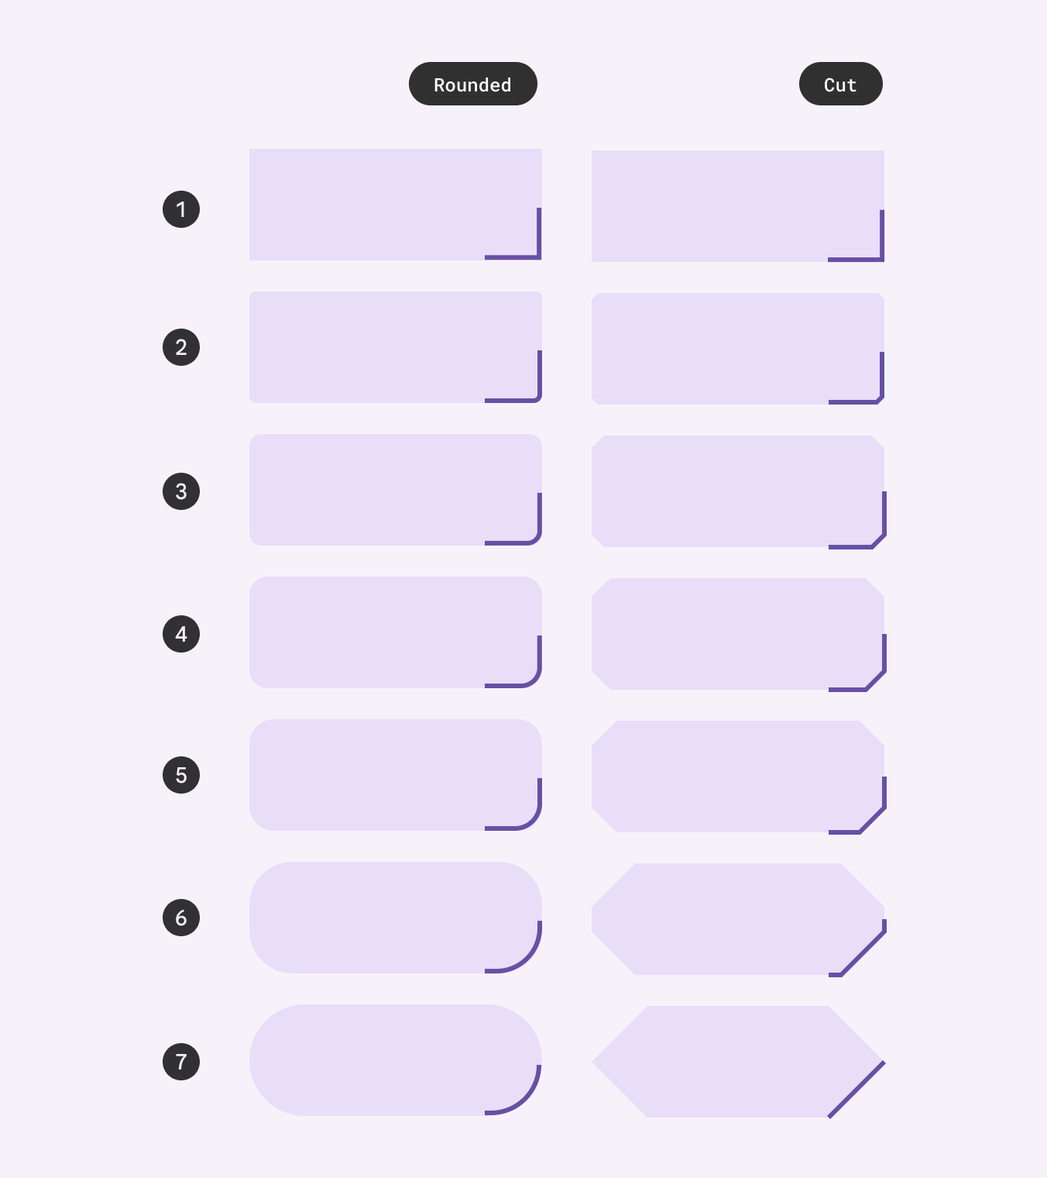
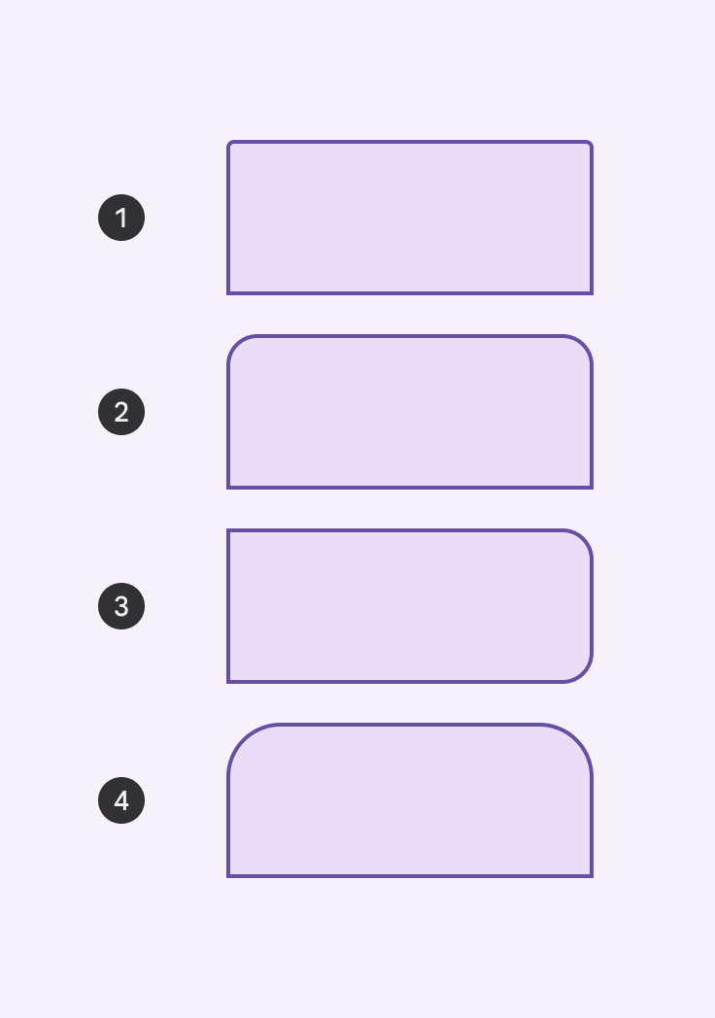

1. None
2. Extra small
3. Small
4. Medium
5. Large
6. Extra large
7. Full
1. Extra small top
2. Large top
3. Large end
4. Extra large top
1. Rounded corner
2. Cut corner

Slide 11
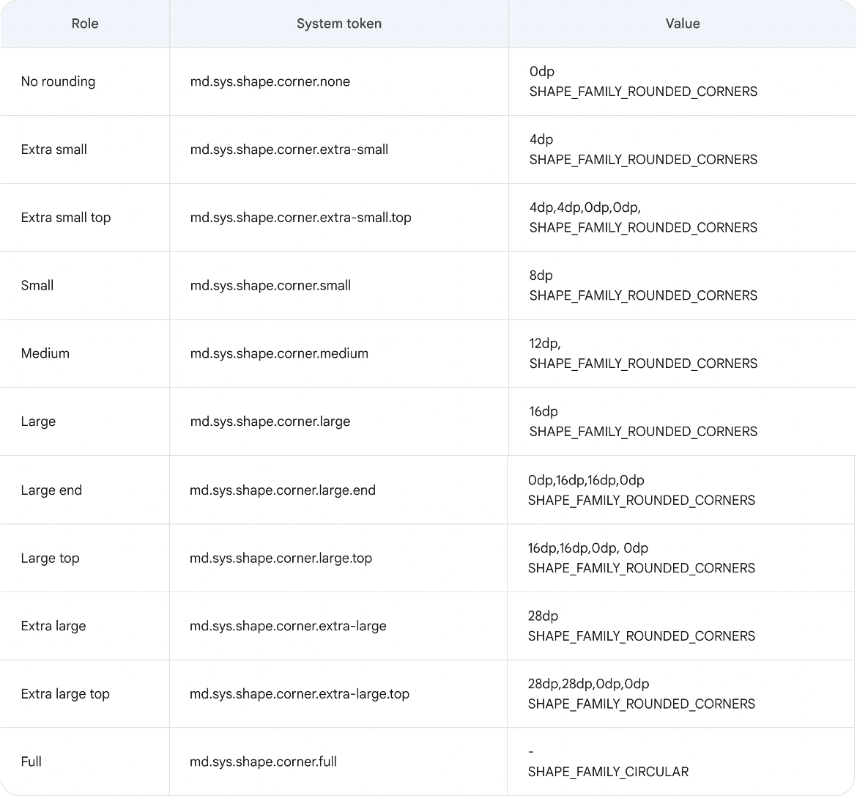

Slide 12
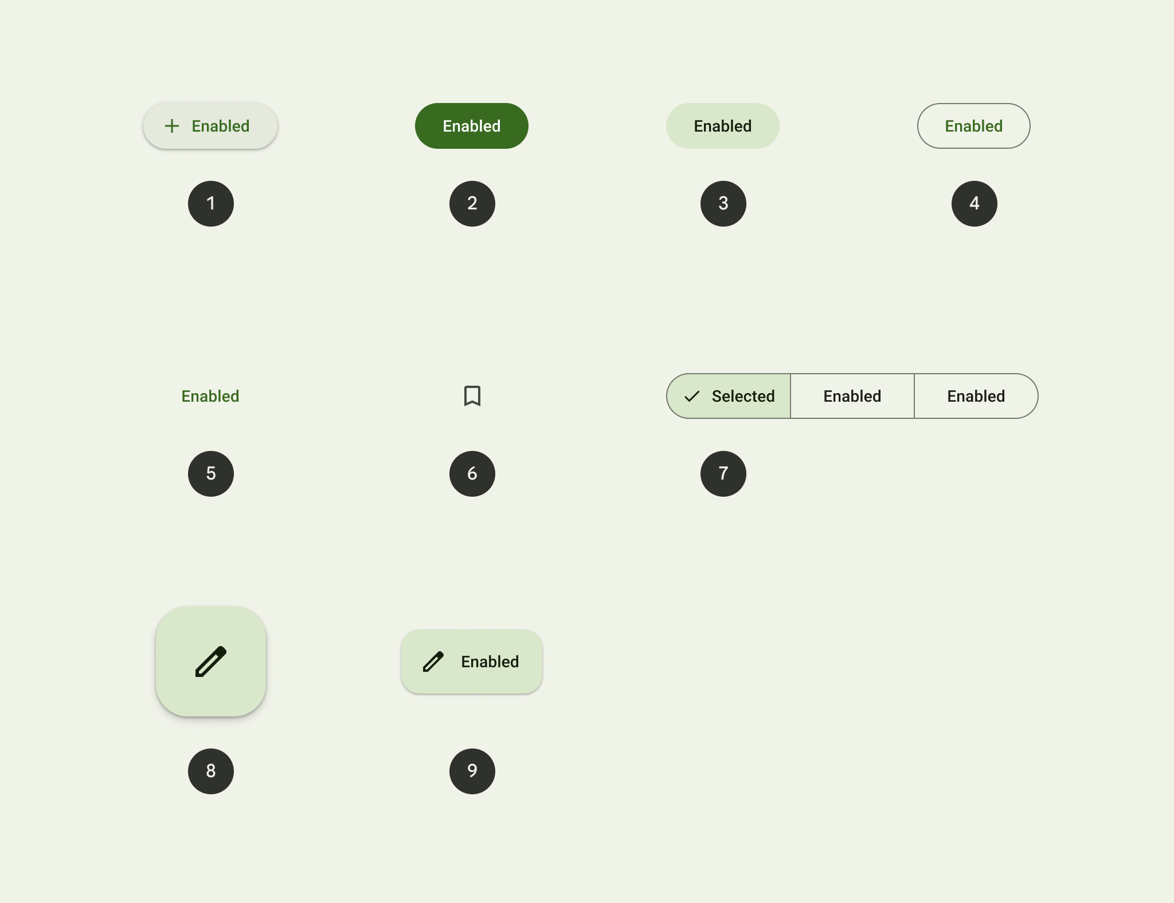
Elevated Button
Filled Button
Filled Tonal Button
Outlined Button
Text Button
Icon Button
Segmented Button
Floating Action Button (FAB)
Extended FAB

Slide 13
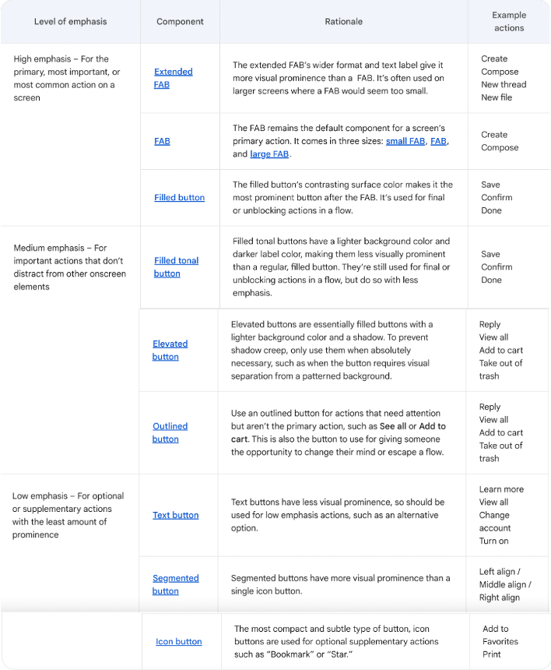

Slide 14
UE

Slide 15
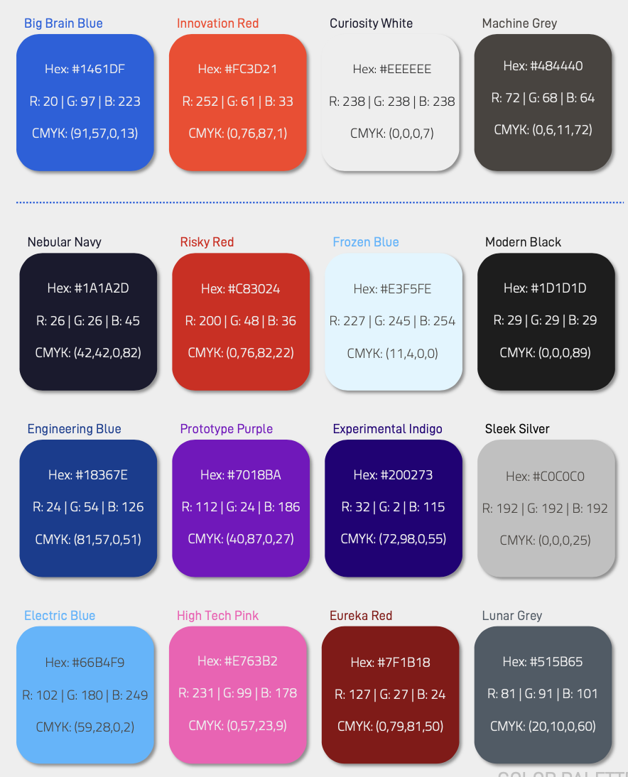

Slide 16
Primary
#2E60D7
On Primary
#EEEEEE
Primary Container
#E3F5FE
On Primary Container
#1A1A2D
Secondary
On Secondary
Secondary Contain.
On Secondary Container
Tertiary
On Tertiary
Tertiary Container
On Tertiary Container
Error
On Error
Error Container
On Error Container
Background
On Background
Surface
On Surface
Outline
Surface-Variant
On Surface Variant

Slide 17
0
10
20
30
40
50
60
70
80
90
95
99
100
#1461DF
#3062D7
#3868DA
#4370DB
#5880DF
#6D90E3
#819FE7
#96AFEB
#ABBFEF
#C1D0F2
#D5DFF7
#EBF0FB
#FFFFFF
0
10
20
30
40
50
60
70
80
90
95
99
100
#E84F33
#E85136
#E1553C
#EA6149
#ED725C
#EF8471
#F19585
#F4A799
#F6B8AE
#F8CAC2
#FADCD6
#FDEEEB
#FFFFFF
0
10
20
30
40
50
60
70
80
90
95
99
100
#484440
#494642
#504E4A
#5A5753
#6C6966
#7F7C7A
#918F8C
#A3A19F
#B6B4B3
#C8C7C6
#DADAD9
#EDEDEC
#FFFFFF

Slide 18
Primary
On Primary
Primary Container
On Primary Container
Secondary
On Secondary
Secondary Contain.
On Secondary Container
Tertiary
On Tertiary
Tertiary Container
On Tertiary Container
Error
On Error
Error Container
On Error Container
Background
On Background
Surface
On Surface
Outline
Surface-Variant
On Surface Variant

Slide 19
Primary
On Primary
Primary Container
On Primary Container
Secondary
On Secondary
Secondary Contain.
On Secondary Container
Tertiary
On Tertiary
Tertiary Container
On Tertiary Container
Error
On Error
Error Container
On Error Container
Background
On Background
Surface
On Surface
Outline
Surface-Variant
On Surface Variant

Slide 20
Primary
On Primary
Primary Container
On Primary Container
Secondary
On Secondary
Secondary Contain.
On Secondary Container
Tertiary
On Tertiary
Tertiary Container
On Tertiary Container
Error
On Error
Error Container
On Error Container
Background
On Background
Surface
On Surface
Outline
Surface-Variant
On Surface Variant

